Slide 1
Manage the Product
Chapter Eight

Slide 2
Chapter Objectives
Explain the different product objectives and strategies a firm may choose
Understand how firms manage products throughout the product life cycle
Discuss how branding strategies create product identity
Explain how packaging and labeling contribute to product identity
Describe how marketers structure organizations for new and existing product management
Copyright © 2013 Pearson Canada Inc.
8-<number>
Notes:
p. 266
LECTURE NOTES:
After completing this chapter, you should be able to:
Explain the different product objectives and strategies a firm may choose
Understand how firms manage products throughout the product life cycle
Discuss how branding strategies create product identity
Explain how packaging and labeling contribute to product identity
Describe how marketers structure organizations for new and existing product management

Slide 3
I. Explain the different product objectives and strategies a firm may choose
Copyright © 2013 Pearson Canada Inc.
8-<number>
Notes:
This slide relates to Learning Objective (hereafter LO) #1 of chapter 8.

Slide 4
Product Planning: Use Product Objectives to Decide on a Product Strategy
Product management
    The systematic and usually team-based approach to coordinating all aspects of a product’s marketing initiative including all elements of the marketing mix
    Also known as brand management
Success of new products comes from well-executed product planning and management
Copyright © 2013 Pearson Canada Inc.
8-<number>
Notes:
This slide relates to LO #1 of chapter 8.
p. 266
LECTURE NOTES:
Firms that plan well succeed. Planning is guided by product management and is more important than ever.
Product management – sometimes called brand management – is a systematic and team-based approach to coordinating all aspects of a product’s marketing mix. Product management strategies and tactics are managed by product managers or brand managers.
Product management is increasingly important due to influence of technology, as firms create products that grow, reach maturity, and decline at faster and faster rates of speed.

Slide 5
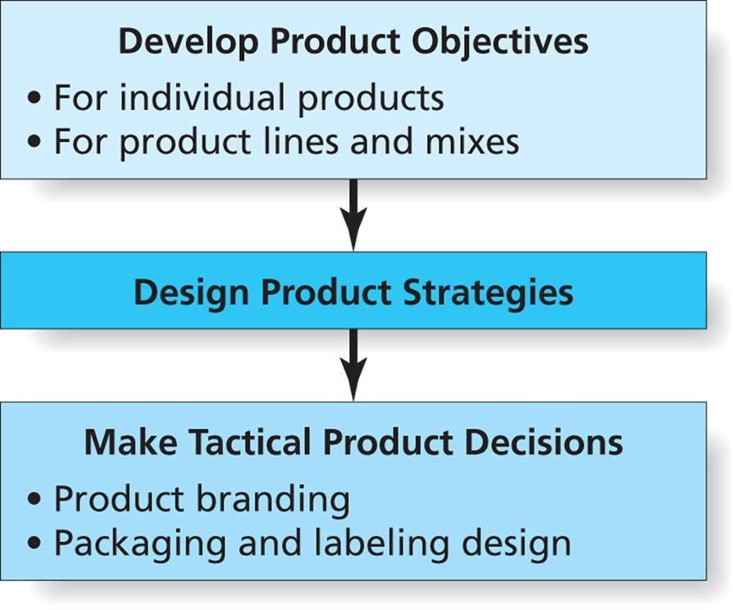
Figure 8.1
Steps to Manage Products
Copyright © 2013 Pearson Canada Inc.
8-<number>
Notes:
This slide relates to LO #1 of chapter 8.
p. 267
LECTURE NOTES:
Product planning includes three steps, beginning with the development of product objectives. Effective product-related objectives must be measurable, clear, unambiguous and feasible. They also must designate a time frame for completion.
The second step involves designing product strategies that allow new or revised brands to compete successfully in the marketplace.
In the final step, these strategies are translated into specific tactics as product/brand managers make specific decisions related to benefits, features, styling, branding, labeling, and packaging.
Each of these topics will be expanded upon and discussed in greater details as we go through the chapter material.

Slide 6
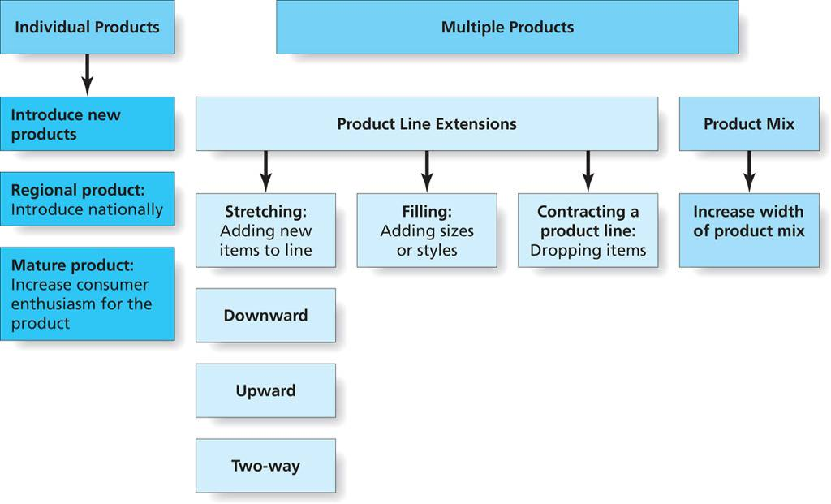
Figure 8.2
Objectives for Single and Multiple Products
Copyright © 2013 Pearson Canada Inc.
8-<number>
Notes:
This slide relates to LO #1 of chapter 8.
p. 268
LECTURE NOTES:
When setting objectives, planners must consider the long-term implications of product decisions. They also should make certain that objectives are consistent with their knowledge of customer needs and competitive products.
Objectives may focus on a single product, or on a group of products, such as a product line. Figure 8.2 illustrates different types of objectives that may be appropriate for individuals and multiple products.

Slide 7
Objectives and Strategies for Individual Products
Successful introduction of new products
Take local or regional products national
Bring new life to mature products while maintaining brand personality
Copyright © 2013 Pearson Canada Inc.
8-<number>
Notes:
This slide relates to LO #1 of chapter 8.
p. 267 – 268
LECTURE NOTES:
Strategies for individual products and the objectives these strategies seek to accomplish can be very different depending upon whether the product is new, regionally focused, or mature.
New product objectives seek accomplishments that will help the product be introduced successfully. One example might be to convince an adequate number of retailers to sell the product for the manufacturer.
An example of a regional product objective may be to expand distribution nationally. Another example might be to adapt the product offering (e.g., restaurant menu) to regional tastes.
Finally, a key objective for a mature product may be to excite consumers about the brand. Another example may be to promote new uses for the brand.

Slide 8
Objectives and Strategies for Multiple Products
Product line
    Firm’s total product offering designed to satisfy a single need or desire of target customers
Product line length
Product line strategies
  Full-line vs. limited-line strategies
  Upward, downward, or two-way line stretch
  Filling out or contracting a product line: Filling out-add new sizes or styles, contracting: reduce by eliminating the unprofitable ones
Cannibalization is a risk: A new pdt steals sales from existing pdt.
Copyright © 2013 Pearson Canada Inc.
8-<number>
Notes:
This slide relates to LO #1 of chapter 8.
p. 268 – 269
LECTURE NOTES:
Most large firms such as P&G sell a set of related products, and strategic decisions often affect two or more of these products simultaneously. This is typical in product lines.
A product line might include different brands that satisfy the same basic need, but which appeal to different groups of consumers. Dawn and Joy are two brands of dish washing liquid. Alternately, a product line might contain different configurations of a particular brand. For example, Tide is available in a liquid and powder form, both of which are available with Bleach or without. The Tide product line contains a number of other variations as well.
The product line length is equal to the number of separate items that comprise the product line.
Full-lines target many customer segments, while a limited line strategy with only a few variations may help improve the firm’s image as a specialist.
Additional product strategies may actively seek to expand or contract the product line. Extending the product line would require that brand managers develop new brands to tap needs currently unmet by the firm.
One method of extending the product line is to stretch it upwards, by adding a high-end or premium brand that either contains more features, or is of higher quality.
Alternately, when economic times are tough, a firm may choose to stretch the line downward by stripping a product of features or developing a “budget” brand. Before stretching the line in this fashion, it’s important for marketers to consider whether adding a low-priced product entry can damage the image of existing brands. It wouldn’t make sense for Rolex to add a low-priced watch and distribute it through K-Mart for example, because doing would so would be detrimental to the image of the Rolex brand name, and thus all brands carrying that name.
The filling out strategy adds new sizes or styles not previously available, while the contraction strategy reduces the number of items in a line by eliminating one or more that are unprofitable.
Before expanding a product line upward, downward, or via a filling strategy, firms must carefully evaluate the degree to which cannibalization is a risk. A new product cannibalizes an existing brand when it steals sales from a product that is already part of the product line.

Slide 9
Product Mix Strategies
Product mix
    The total set of products a firm offers for sale
Product mix width
Product mix strategies
  Width of product mix must be considered
  A mix of product lines usually have some things in common
Copyright © 2013 Pearson Canada Inc.
8-<number>
Notes:
This slide relates to LO #1 of chapter 8.
p. 269 – 271
LECTURE NOTES:
The product mix is the total set of products a firm offers for sale. Developing a product mix strategy requires consideration of the product mix width, meaning the number of different product lines supported by a firm. For example, Avon’s product line includes jewelry, fashion, household items, and off-course, cosmetics.
It’s typical for a manufacturer to develop a mix of product lines that have something in common.

Slide 10
Quality as a Product Objective:
The Science of TQM
Product quality
    The overall ability of the product to satisfy customers’ expectations
    Product objectives often focus on product quality
Total quality management (TQM)
    A management philosophy that focuses on satisfying customers through empowering employees to be an active part of continuous quality improvement
Copyright © 2013 Pearson Canada Inc.
8-<number>
Notes:
This slide relates to LO #1 of chapter 8.
p. 271
LECTURE NOTES:
Product objectives often focus on product quality, especially when marketing objectives seek higher sales or market share increases. Product quality is defined as the overall ability of a product to satisfy customer’s expectations.
Total quality management (TQM) initiatives can help a firm to achieve quality objectives.
TQM is defined as company-wide dedication to the development, maintenance, and continuous improvement of all aspects of the company’s operations. As such, it promotes the attitude among employees that everyone serves customers and that their job is to maximize customer satisfaction, both internally, among employees ( internal customers), and externally among those who buy the product.

Slide 11

Quality Guidelines
ISO 9000
    Standards for quality management
ISO 14000
    Standards concentrate on environmental management
Six Sigma methodology
    Process allowing no more than 3.4 defects per million (getting it right
    99.9997% of the time)
Watch a YouTube video: TQM at Motorola
Copyright © 2013 Pearson Canada Inc.
8-<number>
Notes:
This slide relates to LO #1 of chapter 8.
p. 271 – 272
LECTURE NOTES:
Many firms worldwide seek quality guidelines that can guide TQM efforts. The International Organization for Standardization developed such guidelines for Europe in 1987. Named the ISO 9000, these guidelines established voluntary quality management standards. In 1996, the ISO created the ISO 14000 guidelines which concentration on environmental management.
Despite the fact that these standards apply to European businesses, U.S. companies must comply with these standards if they hope to sell products to firms in these companies.
The Sigma Six method helps firms to improve the quality of their products so that defects are reduced to only 3.4 out of every million units produced.
VIDEO NOTES:
This short (1:02) video succinctly discusses TQM efforts at Motorola and how their efforts ultimately improved product quality so defects per limited to 3.4 in one million.

Slide 12
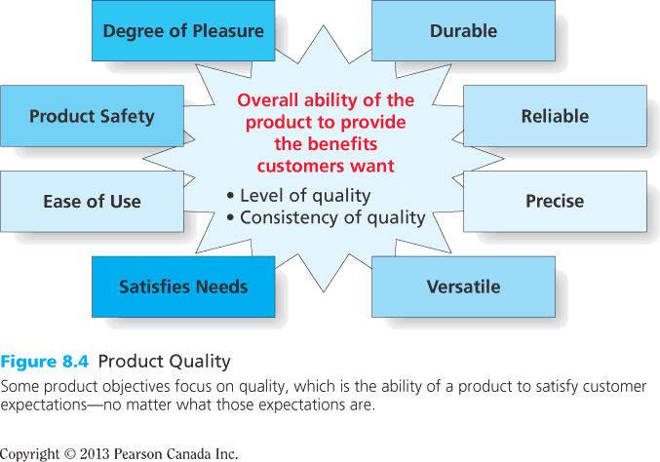
Figure 8.4
Product Quality
Copyright © 2013 Pearson Canada Inc.
8-<number>
Notes:
This slide relates to LO #1 of chapter 8.
p. 272
LECTURE NOTES:
Figure 8.4 summarizes the many meanings of product quality. Different customer expectations, such as durability, versatility, and precision are important for different types of products, though all should satisfy needs. Some customers value reliability, while others value ease of use. Regardless, it is important to recognize that each of these factors contributes to the level and consistency of product quality.

Slide 13
II. Understand how firms manage products throughout the product life cycle
Copyright © 2013 Pearson Canada Inc.
8-<number>
Notes:
This slide relates to LO #2 of chapter 8.

Slide 14
Marketing Throughout the Product Life Cycle
Product life cycle
    A concept that explains how products go through four distinct stages from birth to death
      Introduction
      Growth
      Maturity
      Decline
Copyright © 2013 Pearson Canada Inc.
8-<number>
Notes:
This slide relates to LO #2 of chapter 8.
p. 272

Slide 15
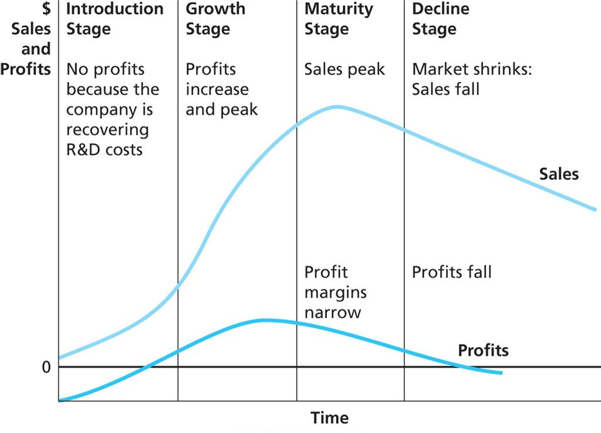
Figure 8.5
The Product Life Cycle
Copyright © 2013 Pearson Canada Inc.
8-<number>
Notes:
This slide relates to LO #2 of chapter 8.
p. 273
LECTURE NOTES:
Figure 8.5 helps marketers understand how a product changes over its lifetime. The model suggests that products go through four distinct stages from birth to death—introduction, growth, maturity, and decline. Sales and profits vary with each stage as shown here.
Understanding the product life cycle is important because different strategies are appropriate at different stages of the product’s life.

Slide 16
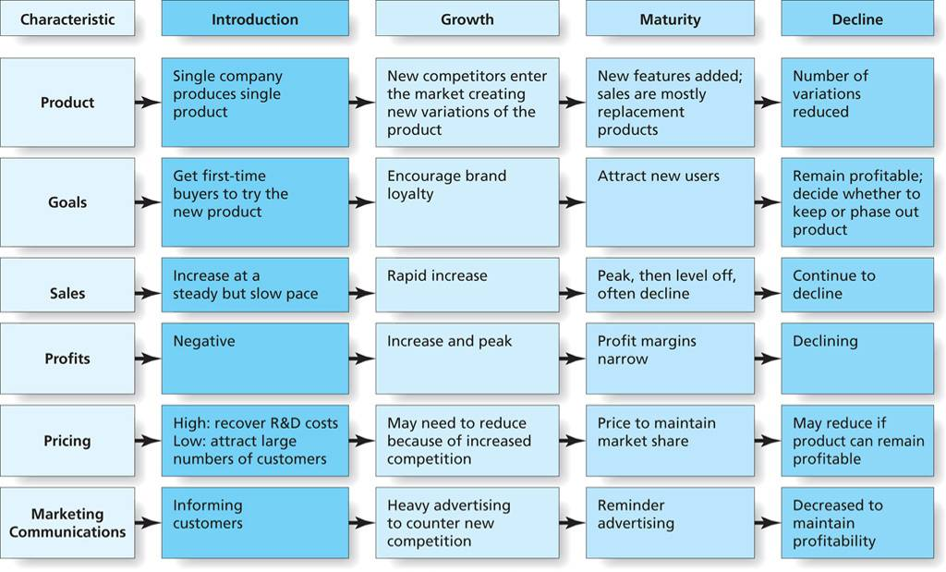
Figure 8.6
Marketing Mix Strategies Through the Product Life Cycle
Copyright © 2013 Pearson Canada Inc.
8-<number>
Notes:
This slide relates to LO #2 of chapter 8.
p. 274
LECTURE NOTES:
The introduction stage:
Slow growth occurs for newly introduced product as the company’s key objective is to get first-time buyers to try product.
The firm does not usually make a profit during this stage. A great deal of money is spent on marketing communications which create awareness for the product and where it can be found. The initial pricing strategy may set a high price more quickly recover R&D expenditures, or a low price to encourage greater sales and market penetration.
It’s impossible to know how long any product will spend in the introduction or any other stage of the product life cycle. The product characteristics discussed in the previous chapter (relative advantage, complexity, compatibility, etc.) influence the rate of adoption. Also, the amount of money that a manufacturer is willing to invest in the product’s start-up can shorten or prolong the introduction stage. And of course, Unfortunately, many products never make it out of the introduction, and lack of a budget for marketing communications is often the problem.

Slide 17
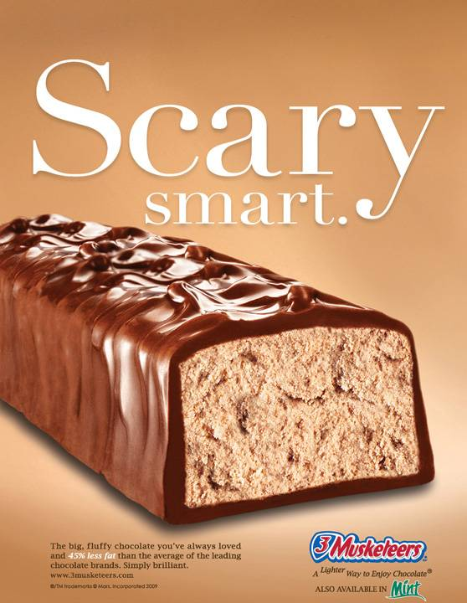
The Introduction Stage
New products that are offshoots of well-known brands have an advantage.
Many products don’t make it out of the introduction phase; poor or insufficient advertising is often the cause.
New product failures
Copyright © 2013 Pearson Canada Inc.
8-<number>
Notes:
This slide relates to LO #2 of chapter 8.
p. 273
WEBSITE NOTES:
It may be worthwhile to visit the link to “10 Famous Product Failures and the Ads that Failed to Sell Them”. This website page provides a synopsis of why each product failed along with a television commercial that was used to introduce the product.

Slide 18
The Growth, Maturity, and Decline Stages
Growth stage
    The product is accepted and sales rapidly increase
Maturity stage
    Sales peak, profit margins narrow
Decline stage
    Sales decrease as customer needs change
Copyright © 2013 Pearson Canada Inc.
8-<number>
Notes:
This slide relates to LO #2 of chapter 8.
p. 275 - 276
LECTURE NOTES:
Growth stage
The product is accepted by the marketplace and sales increase rapidly during the growth stage of the PLC. Marketers key objective is to encourage brand loyalty by convincing consumers of the brand’s superiority. Firms often introduce product variations to attract market segments with different needs and to increase market share. Advertising and sales promotions are especially important to this phase of the life cycle, and price competition may begin to develop between different brands.
Maturity stage
For brands that make it past introduction, maturity is usually the longest phase of the PLC. Sales are at their peak, but the high level of competition often results in price competition and frequent sales promotion, which narrow profit margins. Firms monitor consumer trends and adapt existing products, or bring out new variants, to keep pace with changing consumer needs. Other aspects of the marketing mix may be altered as well.
Decline stage
A steady decrease in sales and profits characterizes the decline phase of the PLC. Often the root cause of declining sales is product obsolescence forced by new technology, or a radical change in consumer needs. The goal of the firm is to remain profitable, and marketers typically must decide whether to stay in the game or phase out a product. A phase out can occur in stages until existing inventory runs out, or the firm can have a fire sale and dump inventory immediately. Firms that decide to keep a product in decline attempt to maximize their profit by minimizing costs: very little investment in advertising or other forms of marketing communications are undertaken. The e-commerce marketplace as extended the life of many products that would have otherwise died without advertising support.

Slide 19

Marketing Mature Products
Marketers need to keep giving consumers new reasons to buy products in the mature stage
This may be accomplished by finding new uses for an existing product, moving into new markets, changing the product’s attributes or by introducing variations to keep consumer interest
Copyright © 2013 Pearson Canada Inc.
8-<number>
Notes:
This slide relates to LO #2 of chapter 8.
p. 275
DISCUSSION NOTES:
Ask students to identify products they feel are in the mature stage, and whether recent advertising reflects one of the tactics discussed on this slide.

Slide 20
BAB235-CH 8 In-class Activity
In groups pick a variety of products in the mature stage (ketchup, salad dressing, laundry detergent, etc) brainstorm product “improvements” to maintain consumer interest in the product (such as colored Ketchup, scented laundry detergent, etc.)
Present to the class
Copyright © 2013 Pearson Canada Inc.
9-<number>

Slide 21
III. Discuss how branding strategies create product identity
Copyright © 2013 Pearson Canada Inc.
8-<number>
Notes:
This slide relates to LO #3 of chapter 8.

Slide 22
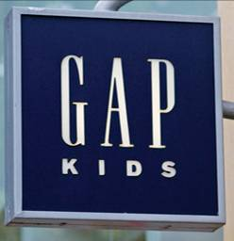
Creating Product Identity:
Branding Decisions
Brand
    A name, term, symbol, or any other unique element that identifies one firm’s product and sets it apart from the competition
What Brands Do The Logos Represent?
Copyright © 2013 Pearson Canada Inc.
8-<number>
Notes:
This slide relates to LO #3 of chapter 8.
p. 276
LECTURE NOTES:
Branding provides the recognition factors products need to succeed in the marketplace. The branding process creates an identity and personality for the product that helps to set it apart from the competition.
Brand marks such as the Nike Swoosh and trade characters like the Keebler Elves are part of the branding process. Logos are also brand marks, such as the GAP logo shown on this slide.
Of course the brand name itself is a major consideration in any branding strategy.
WEBSITE NOTES:
Logos often take the form of symbols that are associated with a particular brand. It might be beneficial to visit this website, and challenge students to identify the brands associated with the various logos shown. The instructor can refer back to some examples of well-known and recognized brand logos vs. those that are not well-know or recognized later in the lecture when discussing brand equity.

Slide 23
What’s in a Name (or a Symbol)?
A “good” brand name
  Maintains relationships with customers
  Positions a product by
    Conveying an image or personality
    Describing how the product works
  Is easy to say, spell, read, and remember
  Fits the target market, product benefits, customer’s culture, and legal
  requirements
Copyright © 2013 Pearson Canada Inc.
8-<number>
Notes:
This slide relates to LO #3 of chapter 8.
p. 276 – 277
LECTURE NOTES:
Good brand names are used to build relationships with customers from the cradle to the grave. For this reason, it is extremely rare for a brand to change it’s name because the constancy of brand name is important. Brand names often help to position products via the image the name portrays or by describing how the brand works or what it actually is, such as “Weedeater”. For example, many brand names use symbolism to imply that a product contains beneficial attributes or certain characteristics. For example, consider the following brand names and what they imply about the product’s characteristics:
Eagle Claw Fishhooks: association—hooks fish deeply and doesn’t let go. Perhaps the PPT author watched too many episodes of Wild Kingdom as a child, but “Eagle claw” evokes vivid mental imagery of an Eagle swooping down, grabbing a fish out of the water with its claws, and flying away into the great blue beyond.
Jaguar: association—exotic, sleek, dangerous, and wild. All positive attributes for a high-end sports car.
However, some brand names can also provide negative cues. Unfortunately, this can sometimes happen when small business people decide to brand their business using their last name. Would you want to do business with “Crook’s” Locksmith company?
Brand names need to be easy to say, so consumers don’t feel self-conscious asking for the product. Making the name easy to spell, read, and remember is also important. Visual impact is important as this helps names be memorable. Incorporating the name into a logo that appears in ads, package designs, websites also aids in creating memorability. For many packaged goods companies good brands also need to be short, so they can be prominently displayed on the product’s package.
Finally, good brand names must fit the target market, fit the product’s benefits, Fit the customer’s culture, and fit legal requirements.

Slide 24
What’s in a Name (or a Symbol)? (ctn’d)
Trademark
    The legal term for a brand name, brand mark, or trade character
    Trademarks legally registered by a government obtain protection for exclusive use in that country
Common-law protection in Canada
Copyright © 2013 Pearson Canada Inc.
8-<number>
Notes:
This slide relates to LO #3 of chapter 8.
p. 277
LECTURE NOTES:
Trademark is the legal term for a brand name, brand mark, or trade character.
Trademarks legally registered by a government obtain protection for exclusive use in that country. This is an important step that must be taken in order to prevent unauthorized usage of the firm’s names or logos. Unfortunately, the trademark applies only in the individual countries where the brand is registered, and a great deal of product counterfeiting occurs abroad.
Even if the brand is not legally registered, the firm can claim legal protection for the brand via common-law protection if the firm has used the name and established it over a period of time.

Slide 25
Why Brands Matter
Brand equity
    A brand’s value to its organization over and above the value of the generic version of the product
Brand equity provides competitive advantage
Brand equity results in brand loyal consumers and attachment
    Self-concept attachment, nostalgic attachment, interdependence, love
Copyright © 2013 Pearson Canada Inc.
8-<number>
Notes:
This slide relates to LO #3 of chapter 8.
p. 277 - 278
LECTURE NOTES:
A brand is a lot more than just the product it represents – the best brands build an emotional connection with customers which in turn contributes to the brand’s equity.
Brand equity refers to a brand’s value to its organization over and above the value of the generic version of the product. Brands with strong equity create competitive advantage for the firm.
For example . . .
Brands with strong equity capture and can hold on to a larger share of the market
Brands with strong equity can also sell their product at prices with higher profit margins
How is this possible? High equity brands – especially those that build an emotional attachment with customers – benefit from highly loyal customers who are strongly attached to the brand. Brand loyal customers are far less likely to respond to sales or promotional efforts offered by competitors. Without the need to compete on the basis of price, the manufacturer of a high equity brand can charge higher prices and limit sales promotion offers.
The types of attachment that consumers may build with a brand vary.
Self-concept attachment: Occurs IF the product helps establish the user’s identity.
Nostalgic attachment: Products that serve as a link with a past self (such as something that reminds you of your childhood) provide nostalgic attachment.
Interdependence refers to the type of attachment that develops if the branded product is part of the user’s daily routine. Certain types of beverages, such as coffee brands or soda drinks often fall into this category.
Love: this level of attachment is highly emotional and occurs when the branded product creates bonds of warmth, passion, or other strong emotions.

Slide 26
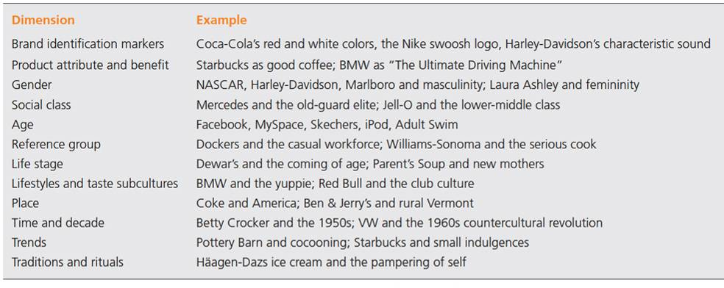
Table 8.1
Dimensions of Brand Meaning
Brand meaning refers to the beliefs and associations that a consumer has about the brand
Copyright © 2013 Pearson Canada Inc.
8-<number>
Notes:
This slide relates to LO #3 of chapter 8.
p. 278 - 279
LECTURE NOTES:
Marketers strive to build strong bonds with customers by creating brand meanings that are relevant to the consumer. Brand meaning refers to the beliefs and associations that a consumers has about the brand.
Table 8.1 summarizes many dimensions of brand meaning.
CLASS ACTIVITY:
Ask students to pick three or four dimensions of brand meaning and challenge them to come up with examples other than are shown in Table 8.1

Slide 27
Why Brands Matter (ctn’d)
Brand storytelling
    Marketers seek to engage consumers with compelling stories about brands
10 characteristics of world’s brands
Copyright © 2013 Pearson Canada Inc.
8-<number>
Notes:
This slide relates to LO #3 of chapter 8.
p. 279 - 280
LECTURE NOTES:
Recall that brand meaning stems from the beliefs and associations a consumer has about the brand. With the increasingly popularity of social networking and all forms of digital communication, marketers are using brand storytelling as a method of building brand meaning. This technique can be particularly effective as brand stories spread virally online from person to person.
Ten characteristics describe the world’s top brands:
The brand excels at delivering the benefits customers truly desire
The brand stays relevant
The pricing strategy is based on consumers’ perceptions value
The brand is properly positioned
The brand is consistent
The brand portfolio and hierarchy make sense
The brand makes use of and coordinates a full repertoire of marketing activities to build equity
The brand’s managers understand what the brand means to consumers
The brand is given proper support and that support is sustained over the long run
The company monitors sources of brand equity
Products with strong brand equity provide brand extension opportunities for marketers, in which new products can be introduced and sold under the same brand name. The new product will attract customers immediately, just because of the name, and the marketers may be able to price it higher than would if introducing an entirely new brand that consumers don’t know.
Touchstone films are targeted at older audiences and often feature more adult content in terms of language and sexual situations that is not appropriate for young children. When Disney decided to expand their movies beyond those targeting young children, they realized the importance of creating a sub-brand that could be marketed separately from existing Disney films, and the Touchstone film brand was born.

Slide 28
10 characteristics of world’s brands
1.The brand excels at delivering the benefits customers truly desire.
2. The brand stays relevant.
3. The pricing strategy is based on consumers’ perceptions of value.
4. The brand is properly positioned.
5. The brand is consistent.
Copyright © 2013 Pearson Canada Inc.
9-<number>

Slide 29
6. The brand portfolio and hierarchy make sense.
7. The brand makes use of and coordinates a full repertoire of marketing activities to build equity.
8. The brand’s managers understand what the brand means to consumers.
9. The brand is given proper support, and that support is sustained over the long run.
10. The company monitors sources of brand equity.
Copyright © 2013 Pearson Canada Inc.
9-<number>

Slide 30
BAB235 In class Activity
1. In Groups List 10 top brands (it may be Abercrombie, Guess, or a B2B like FedEx or UPS).
2. How does the brand illustrate the top 10 characteristics? For example, FedEx is expensive but worthwhile (value) for fast, reliable delivery; FedEx is consistent (same colors),FedEx is positioned properly (upscale, expensive delivery service), etc.
Copyright © 2013 Pearson Canada Inc.
9-<number>

Slide 31
Brand extensions
New products sold with the same brand name
Sub-branding
Creating a secondary brand within a main brand that can help differentiate a product line
Copyright © 2013 Pearson Canada Inc.
9-<number>

Slide 32
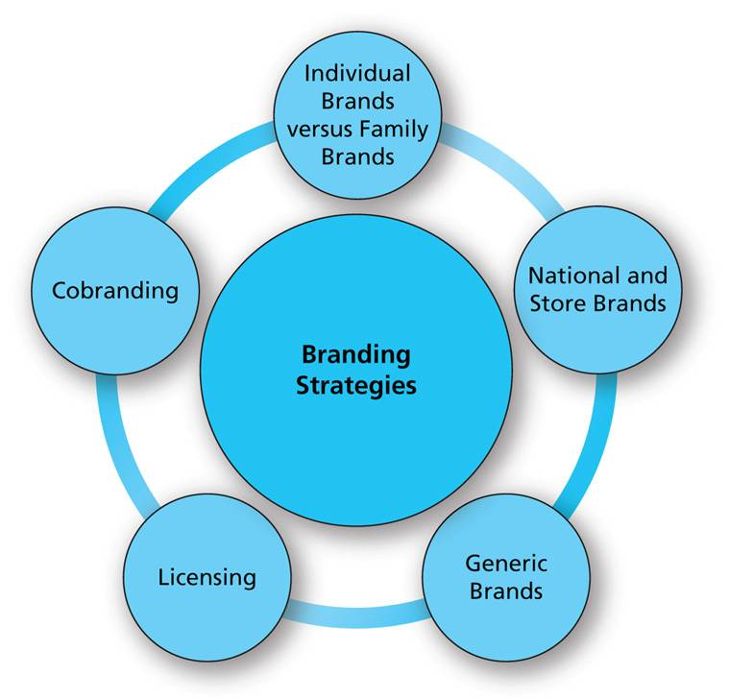
Figure 8.8
Branding Strategies
Copyright © 2013 Pearson Canada Inc.
8-<number>
Notes:
This slide relates to LO #3 of chapter 8.
p. 280
LECTURE NOTES:
The benefits associated with creating a successful brand are so important that branding decisions should not be taken lightly. In fact, marketers spend a great deal of time and effort trying to determine which branding strategy approaches are best used by a firm.
Figure 8.8 illustrates the different branding strategies from which marketers may choose. Each is described in more detail in the following slides.

Slide 33
Branding Strategies
Individual brands
    Use a separate, unique brand for each product item
Family brands
    Market multiple products under the same brand name
    Family brands such as Campbell’s provide an umbrella under which multiple products can be marketed
Copyright © 2013 Pearson Canada Inc.
8-<number>
Notes:
This slide relates to LO #3 of chapter 8.
p. 280 – 281
LECTURE NOTES:
One of the most important decisions a marketers must make is to decide whether to use a separate, unique brand for each item in the product line – called an individual brand strategy, or whether multiple items should be marketed under the same FAMILY brand name. Campbell’s and Sunbeam are two companies that use a family branding strategy.
Individual brands may be better when it is important to concisely communicate what the consumer can expect from the product. Family branding strategies provide instant equity for new products if the family brand is strong. However, having too many brands sometimes leads to the various product items becoming undifferentiated in the eyes of the consumer through poor positioning strategy or poor implementation. General Motors ran into difficulties with this very thing, and the Chevy, Pontiac, Saturn, Cadillac, Buick, Hummer and Saab brands sometimes cannibalized one another (for example, in the mid-size sedan product category).

Slide 34
Branding Strategies (ctn’d)
National (manufacturer) brands
    Brands that the product manufacturer owns
Store (Private-label brands) brands
    Brands that a certain retailer or distributor owns and sells
Generic brands
    A strategy in which products are not branded and are sold at the lowest price possible
Copyright © 2013 Pearson Canada Inc.
8-<number>
Notes:
This slide relates to LO #3 of chapter 8.
p. 281
LECTURE NOTES:
Retailers are increasingly introducing their own brands to compete with those marketed by national manufacturers.
Retailer owned brands are called store brands, or private label brands, compete with national brands by offering lower prices, and continue to gain popularity with consumers. In fact, one study cited in an article on brandchannel.com predicted that the global market share of store brands could reach 50% by 2025.
Generic branded products have fallen out of favor over the years, but prior to the introduction of store brands, presented a low cost alternative to national brands. Generic products are sold in white packages with black letter names that just describe the product itself “Salt” or “Sugar”. In essence, generic products aren’t branded at all – they complete solely on the basis of price.

Slide 35
Branding Strategies
Licensing
    One firm sells the right to another to use a legally protected brand name for a specific purpose and for a specific period of time
Co-branding
    Two brands combine to create a new product
    Provides greater recognition or other strengths than either could achieve alone
    Ingredient branding is increasing
Copyright © 2013 Pearson Canada Inc.
8-<number>
Notes:
This slide relates to LO #3 of chapter 8.
p. 281 – 282
LECTURE NOTES:
Licensing is a branding strategy in which one firms sells the rights to use a brand name for specific purpose and for a specific period of time. To the firm buying the licensing rights gains instant recognition and a short cut to building brand equity.
Co-branding should be beneficial to both parties as the inclusion of both brand names on the product provides greater recognition than either product would be able to achieve on its own.
One of the fastest growing variations of co-branding is called ingredient branding. The difference here is that the licensed brand becomes a component part of a larger product. Not only does ingredient branding attract new customers to the host brand, the ingredient brand benefits through the additional revenue generated by A) the licensing agreement and B) the increased sales of product to the host brand.

Slide 36
Brand Metrics
Approaches to measuring brand equity
  Customer mind-set metrics
  Product-market outcomes metrics
  Financial market metrics
  Revenue premium metric
Copyright © 2013 Pearson Canada Inc.
8-<number>
Notes:
This slide relates to LO #3 of chapter 8.
p. 282 – 283
LECTURE NOTES:
Brand equity represents the value that a branded item has above an beyond the value of a product without a brand name. Measuring brand equity is tricky though. Four sets of metrics are commonly used, though each has its strengths and weaknesses.
Customer mind-set metrics focus on consumer awareness, attitudes, and loyalty toward the brand based on survey data. However these studies rarely if ever provide a single objective measure that a marketer can use to assign a financial value to the brand.
Product-market outcomes metrics focus on the ability of a brand to charge a higher price. Data is typically gathered by surveys that ask consumers to tell how much more they would be willing to pay for one brand compared to others. These types of metrics are based on hypothetical decisions, which may well differ from how people behave in the marketplace, and can be difficult to use.
Financial market metrics are more realistic as they include the purchase price of brand that is acquired or sold, and my include subjective valuations of future stock prices.
The revenue premium metric compare the revenue generated by a brand over a given time period to that generated by a comparable store brand. The difference between the two brands is the value of the brand’s equity.

Slide 37
IV. Explain how packaging and labeling contribute to product identity
Copyright © 2013 Pearson Canada Inc.
8-<number>
Notes:
This slide relates to LO #4 of chapter 8.

Slide 38
What Packages Do
Package
    The covering or container of a product
    Provides product protection, facilitates product use and storage, and supplies marketing communication
Packaging may include
  QR (quick response) code
  UPC (universal product) code
Copyright © 2013 Pearson Canada Inc.
8-<number>
Notes:
This slide relates to LO #4 of chapter 8.
p. 284

Slide 39
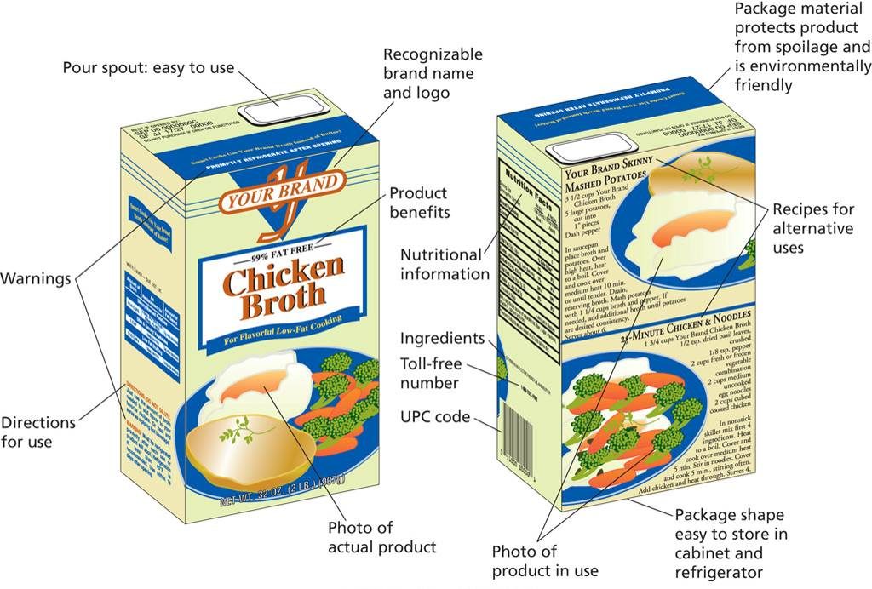
Figure 8.9
Functions of Packaging
Copyright © 2013 Pearson Canada Inc.
8-<number>
Notes:
This slide relates to LO #4 of chapter 8.
p. 285
LECTURE NOTES:
Figure 8.9 illustrates the various functions of packaging. Packages represent the cover or container for a product, Implemented correctly however, good packaging can create a competitive advantage for the brand.
Obviously, packaging provides utilitarian benefits such as protecting the product during transit and facilitating consumer’s handling of the product (easy pour spout) as well its storage (package shape and size).
However, the package can also help to communicate the brand’s personality via the use of color, words, shapes, designs, and pictures.
The package also supplies important information, such as nutritional information, ingredients, benefits, recipes, directions, warnings, toll-free phone numbers, and the UPC code.

Slide 40
Effective Package Design
Effective package design involves consideration of
  Packaging of other brands in the same product category
  Choice of packaging material and the image it projects
  Environmental impact of packaging
  Shape, colour, graphic information
  QR code
Copyright © 2013 Pearson Canada Inc.
8-<number>
Notes:
This slide relates to LO #4 of chapter 8.
p. 285 – 286
LECTURE NOTES:
Effective packaging considers a variety of factors, including packaging of other brands in same product category. National marketers want their package to standout on the shelf and be differentiated from competition. On the other hand, some store brands attempt to mimic a national brand’s package as closely as is legally possible. Walgreen’s is a master at copycat packaging; the strategy allows for more sales as consumers who don’t look carefully enough may accidentally buy the Walgreen’s store brand rather than the national brand they wanted.
In addition to the packaging of other brands in the same product category, marketers must consider the choice of packaging material, and evaluate it with respect to the image that material projects. For example, plastic is often perceived as cheap – not the best packaging choice for a brand attempting to establish an elite brand image.
As sustainability becomes more important to both consumers and the corporate world, the environmental impact of different packaging choices will become increasingly important. Is the package made of recycled materials? Is it biodegradable? Does it use less packaging materials? Of course the environmental impact must be balanced against consumer needs and desires. As the text mentions, refill pouches had a relatively short life, as the majority of consumers didn’t like having to transfer the refill liquid into the existing spray bottle or container.
The shape and colors used on the package can be very helpful in creating brand meaning. Curved shapes are feminine, square and angular shapes are masculine. White communicates purity, while green is associated with health, vegetables, and a minty flavor.
Graphics can be used to show the results of using the product, the type of person who should be purchasing the product, or the product itself.

Slide 41
Labeling Regulations
In Canada
The Consumer Packaging and Labeling Act
  Aims to make labels more helpful to consumers by providing useful information
The Food and Drug Regulation
  Makes nutrition labelling mandatory on most pre-packaged foods
  Requires that all food labels list the sources of common food allergens, gluten, and sulphites in pre-packaged products
Copyright © 2013 Pearson Canada Inc.
8-<number>
Notes:
This slide relates to LO #4 of chapter 8.
p. 287

Slide 42
BAB235 CH 8 In-class Activity- Packaging
Assume that you have recently been hired by Kellogg, the cereal manufacturer. You have been asked to work on a plan for redesigning the packaging for Kellogg’s cereals
Visit Kellogg website and familiarize yourself with the different packages that has been used in the past
In a roleplaying situation, in groups present the following report to the class.
a. Discussion of the problems or complaints customers have with current packaging
b. Several different package alternatives
c. Your recommendations for changing packaging or for keeping the packaging the same
Copyright © 2013 Pearson Canada Inc.
9-<number>

Slide 43
V. Describe how marketers structure organizations for new and existing product management
Copyright © 2013 Pearson Canada Inc.
8-<number>
Notes:
This slide relates to LO #5 of chapter 8.

Slide 44
Organize for Effective Product Management
Brand managers
    Responsible for developing and implementing the marketing plan for a single brand
Product category managers
    Responsible for developing and implementing the marketing plan for all the brands and products within a product category
Market managers
    Responsible for developing and implementing the marketing plans for products sold to a particular customer group
Copyright © 2013 Pearson Canada Inc.
8-<number>
Notes:
This slide relates to LO #5 of chapter 8.
p. 287 - 288

Slide 45
Organize for New-Product Development
Venture teams
    Groups of people within an organization who work together to focus exclusively on the development of a new product
“Skunk works”
    Small and isolated venture team in remote location that function with minimal supervision
Copyright © 2013 Pearson Canada Inc.
8-<number>
Notes:
This slide relates to LO #5 of chapter 8.
p. 288
LECTURE NOTES:
Launching new products is a critical activity in many firms. Often venture teams are used as part of the new product development process.
In new product development, venture teams are composed of members that commit so deeply to the new product that they function independent of other departments, and stick with the new product venture team until the product is successfully commercialized, or fails and is abandoned. Venture teams typically report to higher level corporate officers. Sometimes their offices aren’t even located in the corporate building, but instead may be found at a remote location, colorfully called a “Skunk works.”

Slide 46
All rights reserved. No part of this publication may be reproduced, stored in a retrieval system, or transmitted, in any form or by any means, electronic, mechanical, photocopying, recording, or otherwise, without the prior written permission of the publisher. Printed in Canada.
Copyright © 2013 Pearson Canada Inc.
8-<number>

